Slide 1
Connecting With Your Audience
by
Azhar Borhan
24th May 2011

Slide 2
Content creation subsidiary of Media Prima group
5,000 hours of content for TV, 6 to 10 movies per year

Slide 3
Who are our audience?
How well do we know them?

Slide 4
The audience
English
Kids
Professionals & Executives
Traditional
Urban
Malay
Modern
Youths
Mass
Indian
Chinese
Aspirational
Housewives
Young families
Working women

Slide 5
Media Prima Berhad group of companies
Television Broadcasting
Content Creation
Print
Events
Radio
Outdoor
New Media
Network Portals

Slide 6
Media Prima Berhad group of companies
Television Broadcasting
Content Creation
Print
Events
Radio
Outdoor
New Media
Network Portals

Slide 7
Mass families, all Malaysians
Urban families
Kids
Chinese families
Young Urban 15 – 29 years old
Chinese / English speaking
Young Malay families < 35 years old
Kids and youth

Slide 8
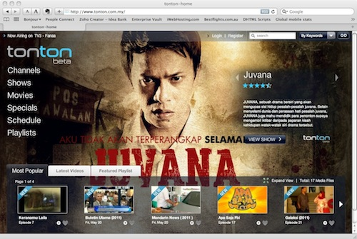
Total viewership
=

Slide 9
The delivery method and platform is as important as the content itself

Slide 10
Conversations are as important as ratings
If its good, they’ll tell others, who’ll tell more friends, who’ll tell their friends, who’ll tell more friends…
Social networking = powerful promotion
Significant increase in exposure and consumption of the content

Slide 11
=
=
+
+

Slide 12
Teaser
Main content
Apps & interactivity

Slide 13
Relevance
Relevance is more than just picking topics which match viewers’ interests
Relevance also comes through portraying values and beliefs the audience can identify with

Slide 14
Values and beliefs
Up-bringing & education
Family, friends, people who matter to us
Religious beliefs
Cultural background
Economic and political environment

Slide 15
Engaging stories
More than just the subject matter
Characters, dreams, conflicts, achievements
Drama is no longer just a genre
Drama has become increasingly integral in telling stories across many genres

Slide 16
Fulfilling personal needs
Food and travel shows – play on a basic need and our desire to experience new things
Higher level needs are targeted in shows portraying luxury activities or successful corporate figures – appealing to the affluent and ambitious

Slide 17
Summary
Know your audience as intimately as possible
Make your content relevant to their needs
Adapt the content to the capabilities of each delivery platform & create a total experience
Trigger positive conversations to build attention and maximise exposure and content consumption
Tell compelling stories

Slide 18
Thank you

